Slide 1
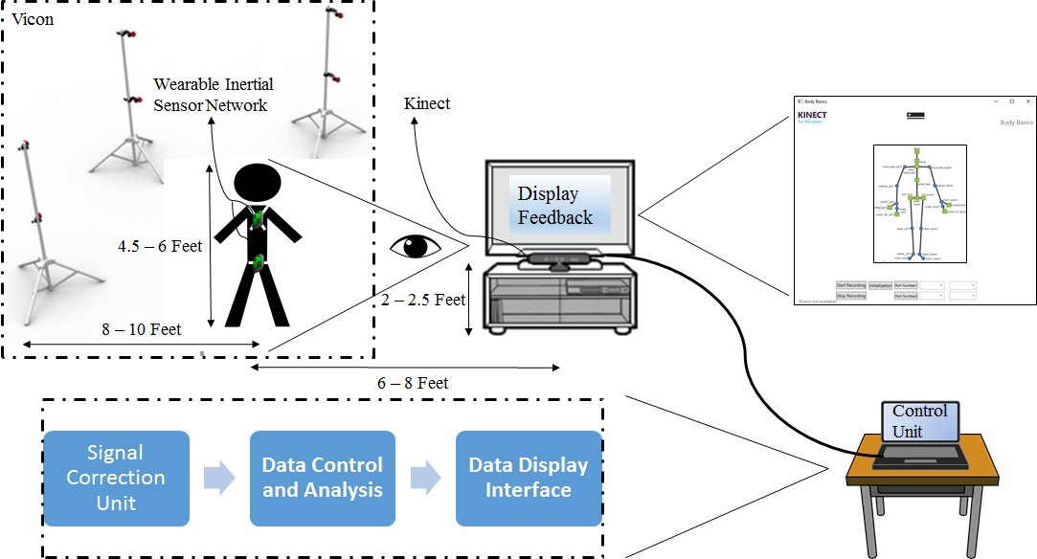
Team 7 Wearable Computers for the Quantification of Lower Back Disorders
Ben Johnston, Benny Chan, Kevin Burns, Alex Dubois
Mentored by: Dr. Roozbeh Jafari of Embedded Signal Processing Lab at Texas A&M University

Slide 2
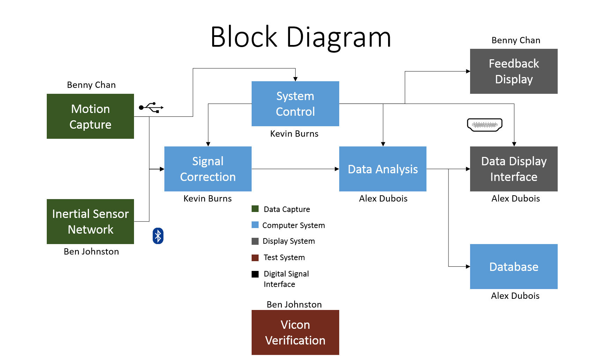

Slide 3
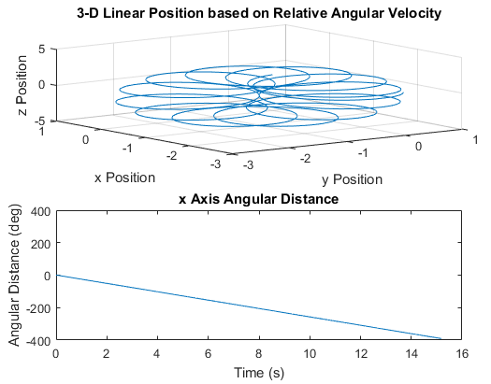
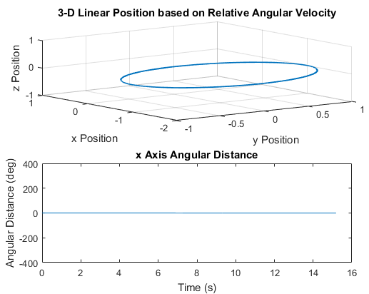
Resultant data from sensors placed on rotating record player.
Raw Data
Corrected Data

Slide 4
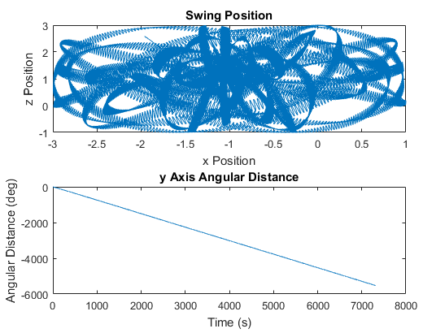
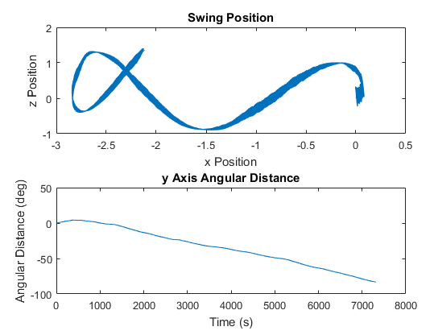
Swing Testing
2 hour long testing not viable (should display one straight curved line)
Raw Data
Corrected Data

Slide 5
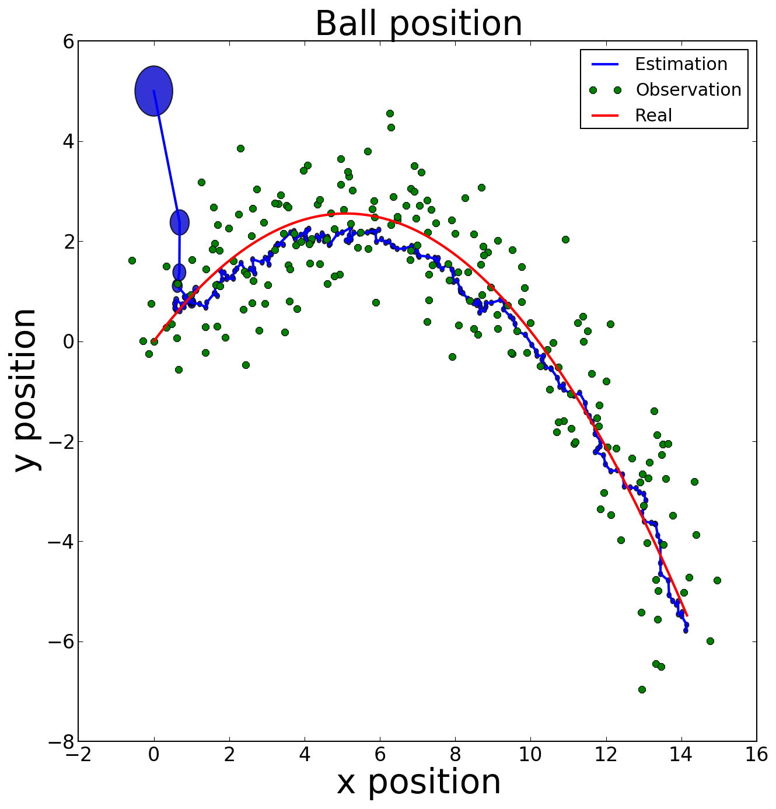
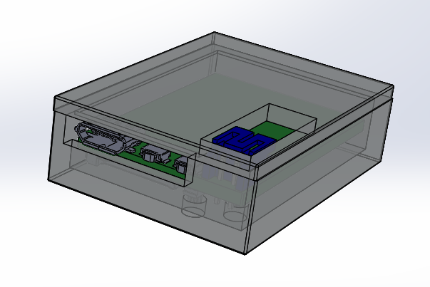
Kalman Filter Example
3D Printed Enclosure – Rough Draft

